Slide 1

LECTURE 3: Requirements Engineering
Liang Xiao
Notes:
http://office.microsoft.com/clipart/default.aspx

Slide 2
Topics
Requirements Engineering Process
Requirements and User Stories
Granularity, Testing, Types, and Prioritization of Requirements
Effort Estimation (Agile Methods)

Slide 3
Requirements Process
Requirements engineering starts with the problem definition: customer statement of work / customer statement of requirements (an informal description of what the customers think they need from a software system to do for them).
Defining the requirements for the system-to-be includes both fact-finding about how the problem is solved in the current practice as well as envisioning how the planned system might work.
Final outcome of requirements engineering: a requirements specification document.

Slide 4
Requirements Process (different methodologies follow the same requirements process)
Aspect-Oriented Requirements
Object-Oriented Analysis & Design
Requirements gathering
Requirements analysis
Requirements specification
Structured Analysis & Design
Agile Development User Stories

Slide 5
Requirements Engineering Components
Requirements gathering
  (a.k.a. “requirements elicitation”) helps the customer to define what is required: what is to be accomplished, how the system will fit into the needs of the business, and how the system will be used on a day-to-day basis
  rarely precise and complete
Requirements analysis
  refining and modifying the gathered requirements
  driven by the creation and elaboration of user scenarios that describe how the end-user will interact with the system
  a popular tool: use cases
Requirements specification
  documenting the system requirements in a semiformal or formal manner to ensure clarity, consistency, and completeness
  UML graphical models such as use cases to describe the function and quality of the software-to-be

Slide 6
Requirements and Specification
Problem domain
Software (Solution) domain
Describes
Requirements
Specifi
cation
Program
Customer
Specifies
Analyzes
Develops
Software Engineer

Slide 7
Traditional prescriptive processes are characterized by their heavy emphasis on getting all the requirements right and written early in the project

Slide 8
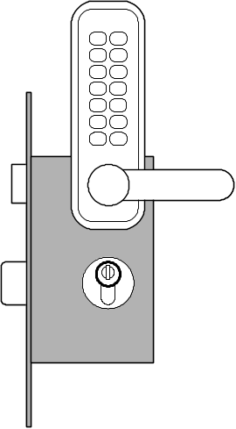
Example System Requirements
Identifier | Priority | Requirement
REQ1 | 5 | The system shall keep the door locked at all times, unless commanded otherwise by authorized user. When the lock is disarmed, a countdown shall be initiated at the end of which the lock shall be automatically armed (if still disarmed).
REQ2 | 2 | The system shall lock the door when commanded by pressing a dedicated button.
REQ3 | 5 | The system shall, given a valid key code, unlock the door and activate other devices.
REQ4 | 4 | The system should allow mistakes while entering the key code. However, to resist “dictionary attacks,” the number of allowed failed attempts shall be small, say three, after which the system will block and the alarm bell shall be sounded.
REQ5 | 2 | The system shall maintain a history log of all attempted accesses for later review.
REQ6 | 2 | The system should allow adding new authorized persons at runtime or removing existing ones.
REQ7 | 2 | The system shall allow configuring the preferences for device activation when the user provides a valid key code, as well as when a burglary attempt is detected.
REQ8 | 1 | The system should allow searching the history log by specifying one or more of these parameters: the time frame, the actor role, the door location, or the event type (unlock, lock, power failure, etc.). This function shall be available over the Web by pointing a browser to a specified URL.
REQ9 | 1 | The system should allow filing inquiries about “suspicious” accesses. This function shall be available over the Web.
Problem: Requirements prioritization.
See how solved in agile methods.

Slide 9
Agile:
  it is impossible to identify all the requirements in one pass;
  incremental and iterative attention to different RE stages;
  use “user stories” (a light way to model requirements) to capture customer needs and to estimate effort and plan releases.

Slide 10
User Stories
As a tenant, I can unlock the doors to enter my apartment.
user-role
(benefactor)
capability
business-value
REQ1 | 5 | The system shall keep the door locked at all times, unless commanded otherwise by authorized user. When the lock is disarmed, a countdown shall be initiated at the end of which the lock shall be automatically armed (if still disarmed).
A user story is a brief description of a piece of system functionality as viewed by a user. It represents something a user would be likely to do in a single sitting at the computer terminal.
Similar to system requirements, but focus on the user benefits, instead on system features: user-centered.
Preferred tool in agile methods.

Slide 11
Example User Stories
Identifier | User Story | Size
ST-1 | As an authorized person (tenant or landlord), I can keep the doors locked at all times. | 4 points
ST-2 | As an authorized person (tenant or landlord), I can lock the doors on demand. | 3 pts
ST-3 | The lock should be automatically locked after a defined period of time. | 6 pts
ST-4 | As an authorized person (tenant or landlord), I can unlock the doors. (Test: Allow a small number of mistakes, say three.) | 9 points
ST-5 | As a landlord, I can at runtime manage authorized persons. | 10 pts
ST-6 | As an authorized person (tenant or landlord), I can view past accesses. | 6 pts
ST-7 | As a tenant, I can configure the preferences for activation of various devices. | 6 pts
ST-8 | As a tenant, I can file complaint about “suspicious” accesses. | 6 pts
Size: the estimated effort size for each story

Slide 12
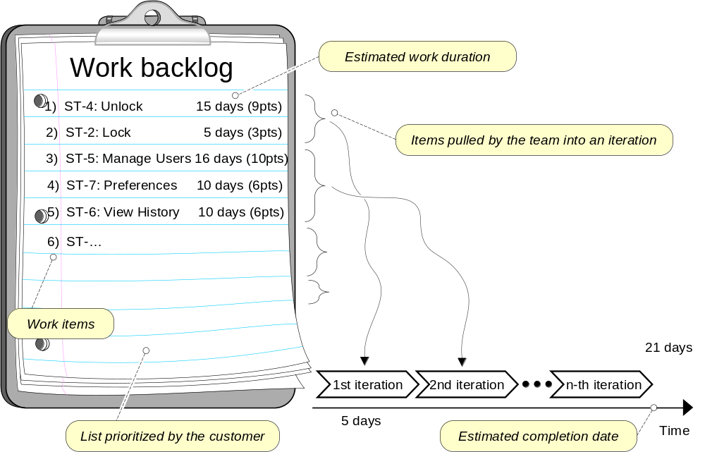
Dynamic Prioritization of User Stories

Slide 13
Granularity of requirements
Testing for requirements
Types of requirements
Prioritization of requirements

Slide 14
Granularity of requirements
Testing for requirements
Types of requirements
Prioritization of requirements

Slide 15
Granularity of requirements
Requirements should be individually testable.
If there is a compound requirement that failed, it may not be clear what part of the requirement has failed.

Slide 16
To test requirement REQ1, and the door was found unlocked when it should have been locked, the entire requirement would fail.
REQ1 | 5 | The system shall keep the door locked at all times, unless commanded otherwise by authorized user. When the lock is disarmed, a countdown shall be initiated at the end of which the lock shall be automatically armed (if still disarmed).
Whether the system accidentally disarmed the lock, or the autolock feature failed?

Slide 17
Splitting up REQ1
REQ1a: The system shall keep the doors locked at all times, unless commanded otherwise by authorized user.
REQ1b: When the lock is disarmed, a countdown shall be initiated at the end of which the lock shall be automatically armed (if still disarmed).

Slide 18
Yet elemental requirements may not be able to describe a stand-alone, meaningful unit of functionality—only together they make sense.

Slide 19
Granularity of requirements
Testing for requirements
Types of requirements
Prioritization of requirements

Slide 20
Requirements - Testing
Test-Driven Development (TDD)
Every step in the development process must start with a plan of how to verify that the result meets a goal
The developer should not create a software artifact (a system requirement, a UML diagram, or source code) unless they know how it will be tested
But, testing is not enough…

Slide 21
TDD: we write tests for the requirements during the requirements analysis.
These tests are known as user acceptance tests (UATs).

Slide 22
User Acceptance Tests (UATs)
Means of assessing that the requirements are met as expected
Conducted by the customer
An acceptance test describes whether the system will pass or fail the test, given specific input values
Cannot ever guarantee 100% coverage of all usage scenarios, but systematic approach can increase the degree of coverage

Slide 23
Test case
The customer can work with a programmer or tester to write the actual test cases.
A test case is a particular choice of input values to be used in testing a program and expected output values.
A test is a finite collection of test cases.

Slide 24
REQ3 | 5 | The system shall, given a valid key code, unlock the door and activate other devices.
For the requirement REQ3, the customer may suggest these test cases
  Test with the valid key of a current tenant on his or her apartment (pass)
  Test with the valid key of a current tenant on someone else’s apartment (fail)
  Test with an invalid key on any apartment (fail)
  Test with the key of a removed tenant on his or her previous apartment (fail)
  Test with the valid key of a just-added tenant on his or her apartment (pass)

Slide 25
Granularity of requirements
Testing for requirements
Types of requirements
Prioritization of requirements

Slide 26
Types of Requirements
Functional Requirements
  system’s expected behavior and the effects it should produce in the problem domain - the main product features
Non-functional requirements
  quality characteristic, etc. maintain a persistent data backup for the cases of power outages
  FURPS+: Functionality (security), Usability, Reliability, Performance , Supportability
On-screen appearance requirements

Slide 27
Testing for non-functional requirements?
All requirements must be written so that they are testable.
We often hear that a system should be “easy to use.” - But how to design tests to verify such a claim?
There is little value in writing requirements that are not testable.

Slide 28
Testing for non-functional requirements (usability)?
For the case study of safe home access system, consider the time constraints of user type and produce order-of-magnitude time limits for computer interaction required to accomplish a certain activity
  the user interacting with the door device expects that the number of keystrokes, clicks, or touches will be minimized for quick task completion
  the property manager interacting with the desktop computer is less concerned with efficiency and more with rich features to review the data and examine trends

Slide 29
Testing for non-functional requirements (reliability)?
Different reliability requirements for different devices
  The door device must be highly reliable (e.g., system failure rate of 4 in a year or less)
  The desktop application can tolerate much lower reliability level

Slide 30
Fun & Non-fun requirements are intertwined
Satisfying a non-functional requirement usually necessitates modifications in the system function: if performance objectives cannot be met, some functional features may need to be left out.

Slide 31
Do not regard non-functional requirements as secondary to functional requirements – these affect customer or user satisfaction with the product

Slide 32
On-screen Appearance Requirements
Do not waste your time and your customer’s time by creating elaborate screen shots with many embellishments, coloring, shading, etc., that serves only to distract attention from most important aspects of the interface
Hand-drawing the proposed interface forces you to economize and focus on the most important features
Only when there is a consensus that a good design is reached, invest effort to prototype the interface

Slide 33
On-screen Appearance Requirements
REQ7 | 2 | The system shall allow configuring the preferences for device activation when the user provides a valid key code, as well as when a burglary attempt is detected.
For the requirement REQ7, the user should be allowed to configure the preferences for activating various household devices in response to different events.
The preferences would be set up using a user interface.

Slide 34
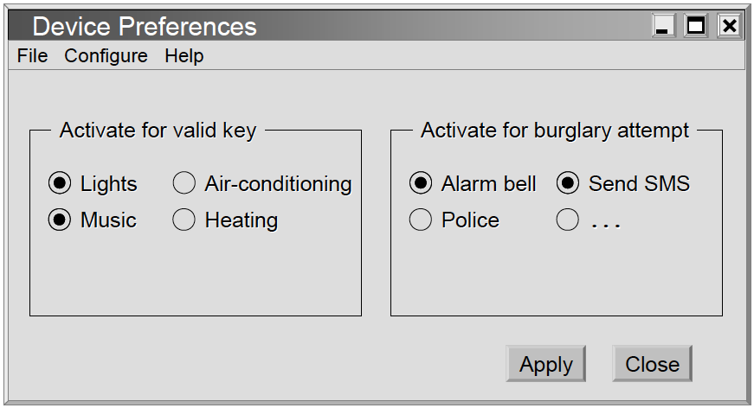
On-screen Appearance Requirements

Slide 35
On-screen Appearance Requirements
Not to advocate user interface design at this early stage of project development.
Drawing sketches of user interfaces for eliciting what the customer needs and how he would like to interact with the system, and for the developer to understand the customer’s needs as early as possible.

Slide 36
Granularity of requirements
Testing for requirements
Types of requirements
Prioritization of requirements

Slide 37
Prioritization of requirements
In most cases, not all requirements can be realized because of budgetary or time constraints
Therefore, it is necessary to prioritize the requirements
Method: assigning priority weights to requirements (guessed by customer, subjective)
A systematic method for prioritizing software product requirements is cost-value approach: determine for each candidate requirement its cost of implementing and how much value the requirement would have (customer involved)

Slide 38
Prioritization of requirements
Distinguish four types of requirements
  1. Essential: have to be realized to make the system acceptable to the customer.
  2. Desirable: highly desirable, but not mandatory requirements
  3. Optional: might be realized if time and resources permit
  4. Future: will not be realized in the current version of the system-to-be, but should be recorded for consideration in future versions
The priority of requirements determines the order in which they will be implemented

Slide 39
Tools for Requirements Eng.
Tools, such as user stories and use cases,
used for:
  Determining what exactly the user needs (“requirements analysis”)
  Writing a description of what system will do (“requirements specification”)
Difficult to use the same tool for different tasks (analysis vs. specification)

Slide 40
Project Estimation using User Story Points
Similar to “hedge pruning points” in the first lecture
Points assigned to individual user stories
Total work size estimate:
  Total size = Σ points-for-story i (i = 1..N)
Velocity (= productivity) estimated from experience
  defined as the number of user-story points that the team can complete per single iteration (the unit of time)
  represent the team’s productivity
Estimate the work duration
Project duration =
Path size
Travel velocity

Slide 41
Example User Stories
Identifier | User Story | Size
ST-1 | As an authorized person (tenant or landlord), I can keep the doors locked at all times. | 4 points
ST-2 | As an authorized person (tenant or landlord), I can lock the doors on demand. | 3 pts
ST-3 | The lock should be automatically locked after a defined period of time. | 6 pts
ST-4 | As an authorized person (tenant or landlord), I can unlock the doors. (Test: Allow a small number of mistakes, say three.) | 9 points
ST-5 | As a landlord, I can at runtime manage authorized persons. | 10 pts
ST-6 | As an authorized person (tenant or landlord), I can view past accesses. | 6 pts
ST-7 | As a tenant, I can configure the preferences for activation of various devices. | 6 pts
ST-8 | As a tenant, I can file complaint about “suspicious” accesses. | 6 pts

Slide 42
Agile Estimation of Project Effort
1) Prune Section 6 1 day (2pts)
2 points per day
1 = 4 pts (2 days)
2 = 7 pts (3.5 days)
3 = 10 pts (5 days)
4 = 3 pts (1.5 days)
5 = 4 pts (2 days)
6 = 2 pts (1 day)
7 = 4 pts (2 days)
8 = 7 pts (3.5 days)
2) Prune Section 5 2 days (4pts)
3) Prune Section 7 2 days (4pts)
4) Prune Section 4 1.5 days (3p)
5) Prune Section 8 3.5 days (7p)
Work backlog
Estimated work duration
1) ST-4: Unlock 15 days (9pts)
2) ST-2: Lock 5 days (3pts)
Items pulled by the team into an iteration
3) ST-5: Manage Users 16 days (10pts)
4) ST-7: Preferences 10 days (6pts)
5) ST-6: View History 10 days (6pts)
6) ST-…
Work items
21 days
1st iteration
2nd iteration
n-th iteration
List prioritized by the customer
5 days
Estimated completion date
Time

Slide 43
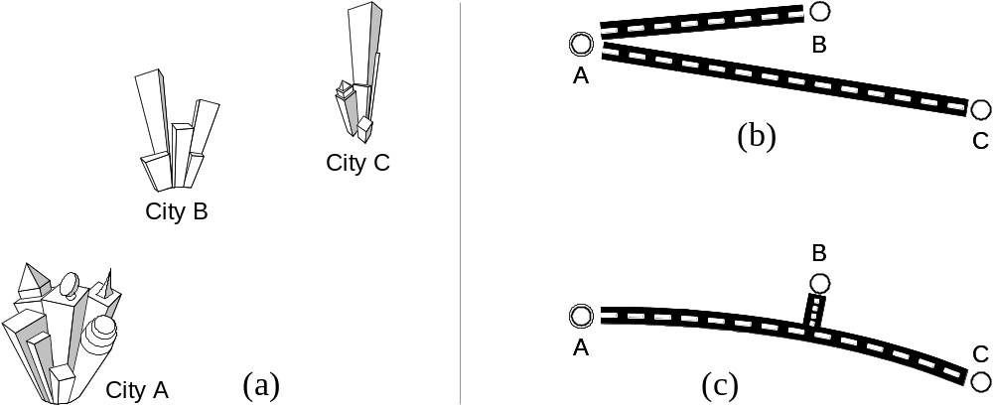
How To Combine the Part Sizes?

Slide 44
How To Combine the Part Sizes?

Slide 45
How To Combine the Part Sizes?
Sharing / Reusing reduces the total effort of work - Costs are not always additive
Consider available component libraries…
- > Simply adding the story sizes introduces a gross in accuracy in the
overall effort estimation

Slide 46
Reuse always means less work?
In fact, solution (c) is not necessarily “cheaper” than (b) …

Slide 47


Additional Costs
Highway traffic-circle interchange
Traffic signs

Slide 48
Why reuse if increases effort?
Preserve resources (conserve the land and protect nature), easier connection, esthetic reasons etc.

Slide 49
Agile methodologists recommendation
Avoiding dependencies between user stories - high dependencies between stories make story size estimation difficult
  Combine the dependent user stories into one larger but independent story
  Find a different way of splitting the stories

